Slide 1

OpenAI API
responses
vision

Slide 2
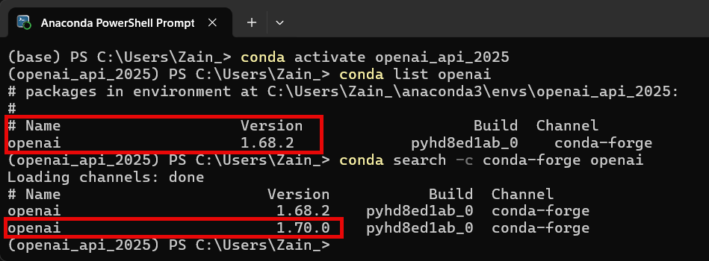
Time to Upgrade! (again)
Notes:
conda install -c conda-forge openai=1.70.0

Slide 3
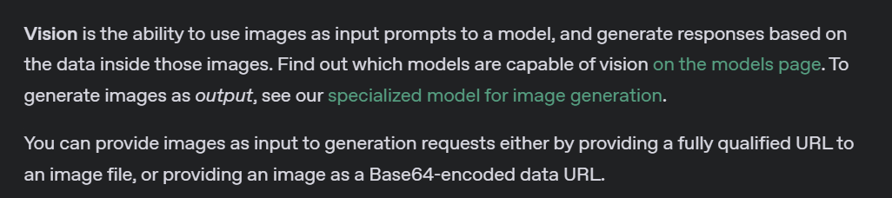
What is Vision?
Notes:
https://platform.openai.com/docs/guides/images?api-mode=responses

Slide 4
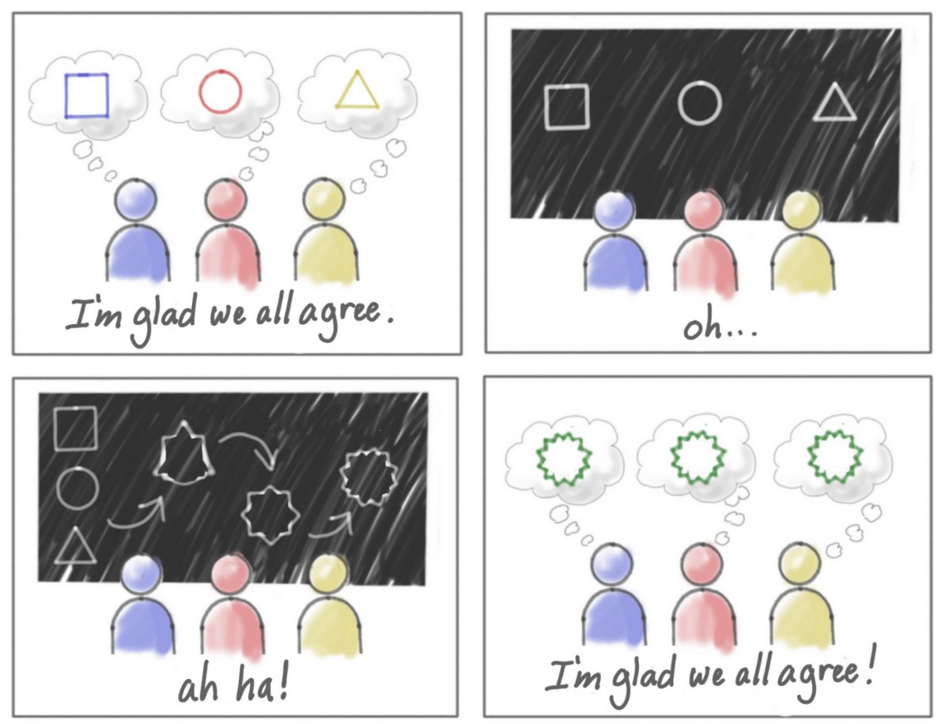
Abstract Ideas
Notes:
What is this cartoon about?

Slide 5
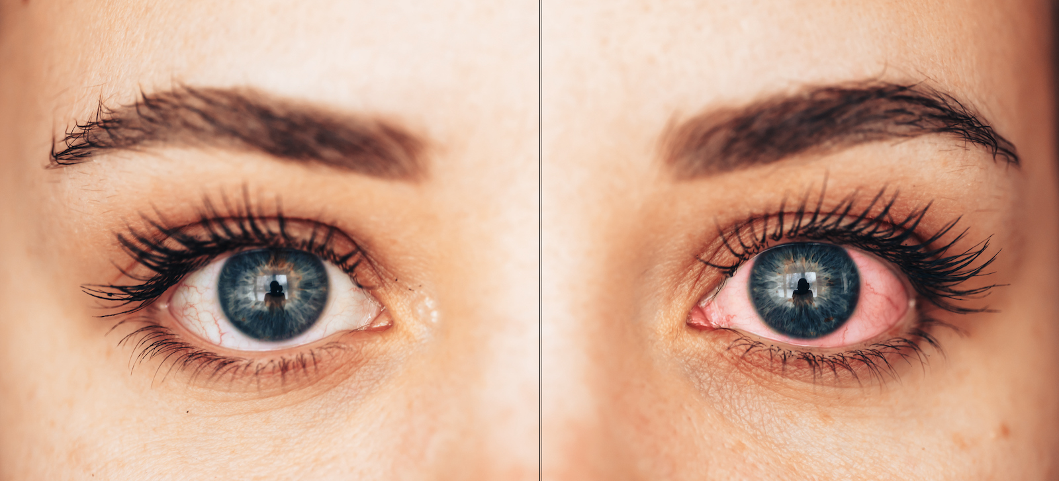
Medical
Notes:
Compare the two eyes, do you see anything wrong?

Slide 6
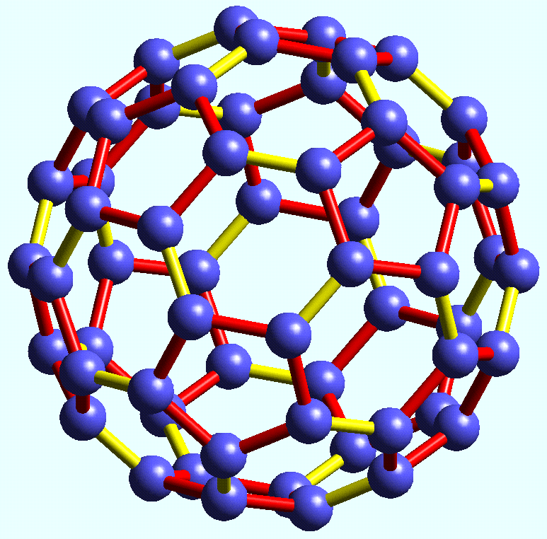
Chemistry
Notes:
What is this object?

Slide 7
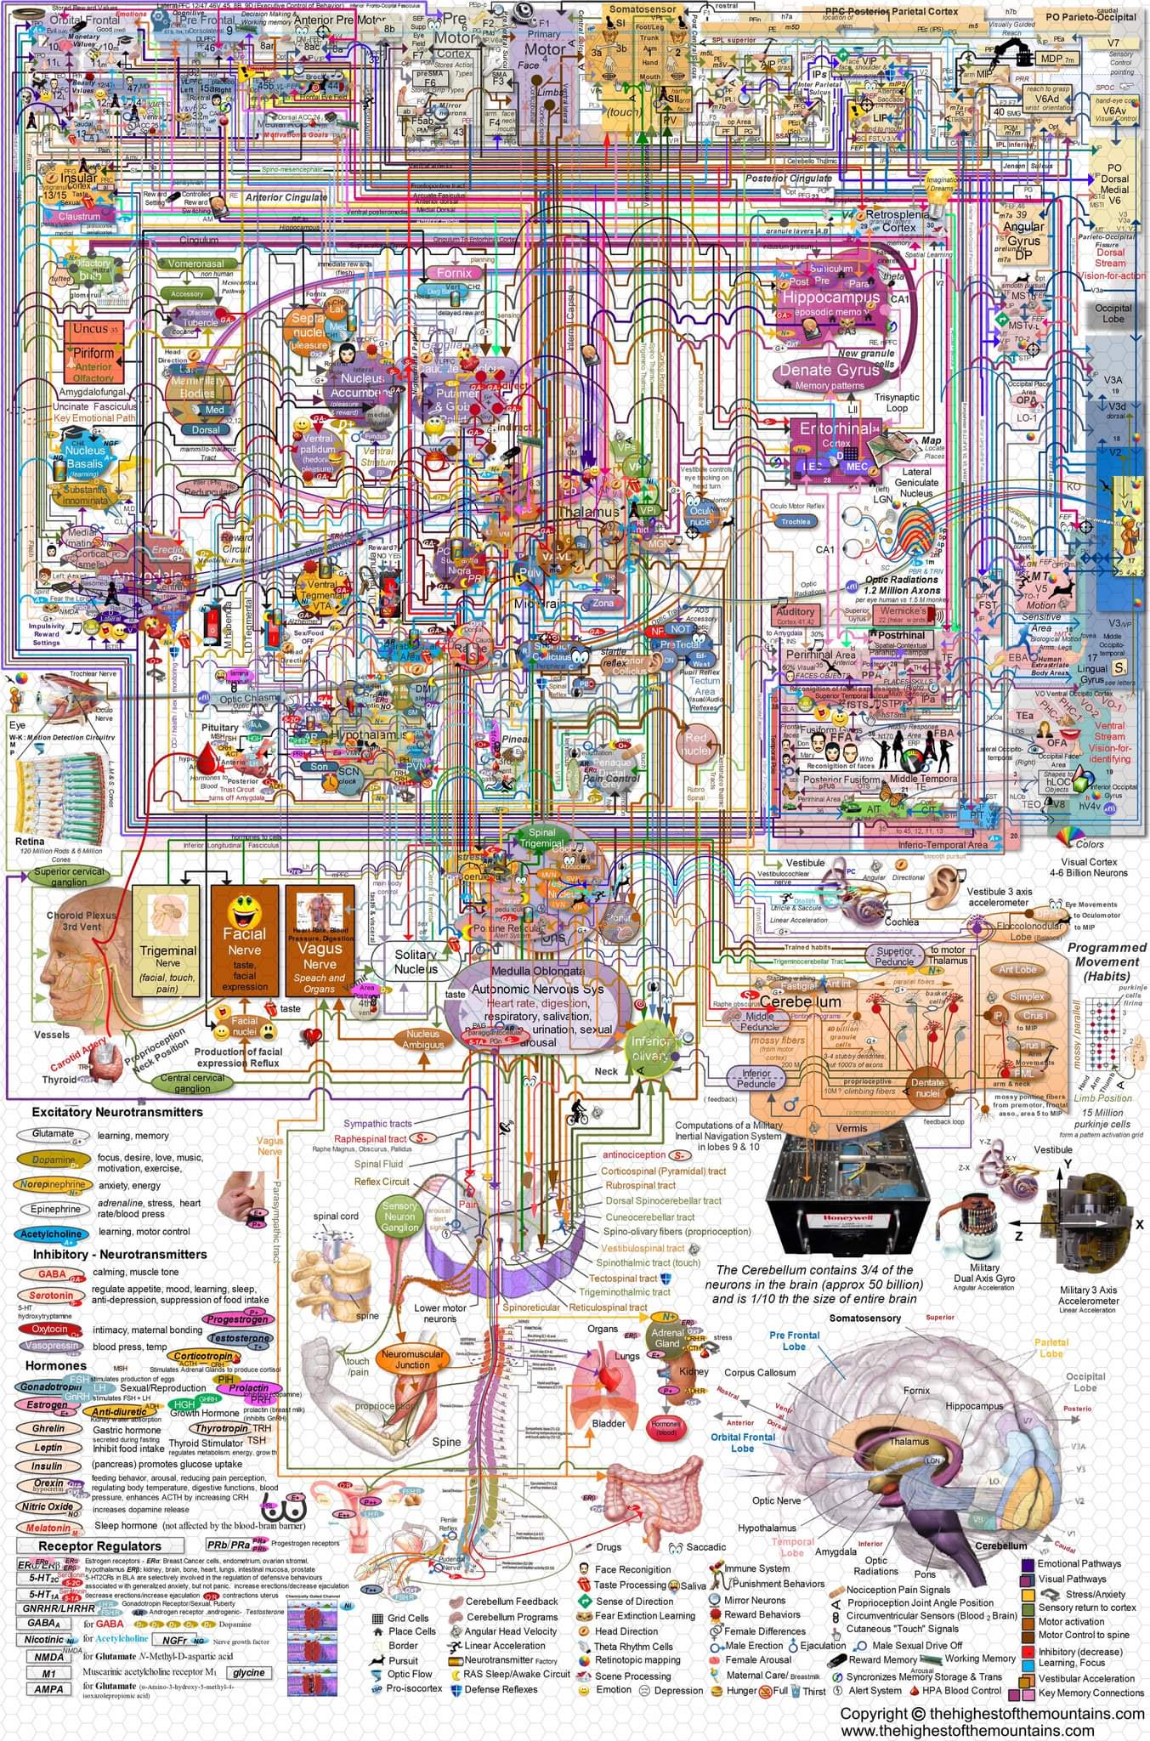
Confusing diagrams
Notes:
What is this diagram about?

Slide 8
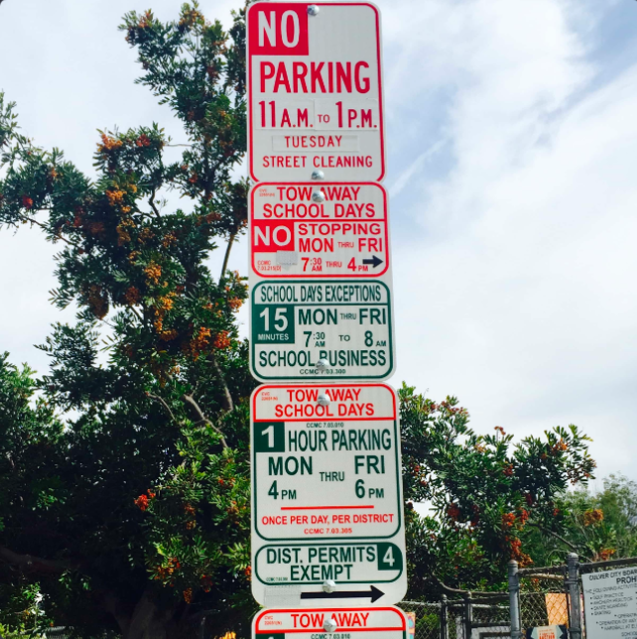
Parking
Notes:
It’s 3pm on Wednesday, can I park here?

Slide 9
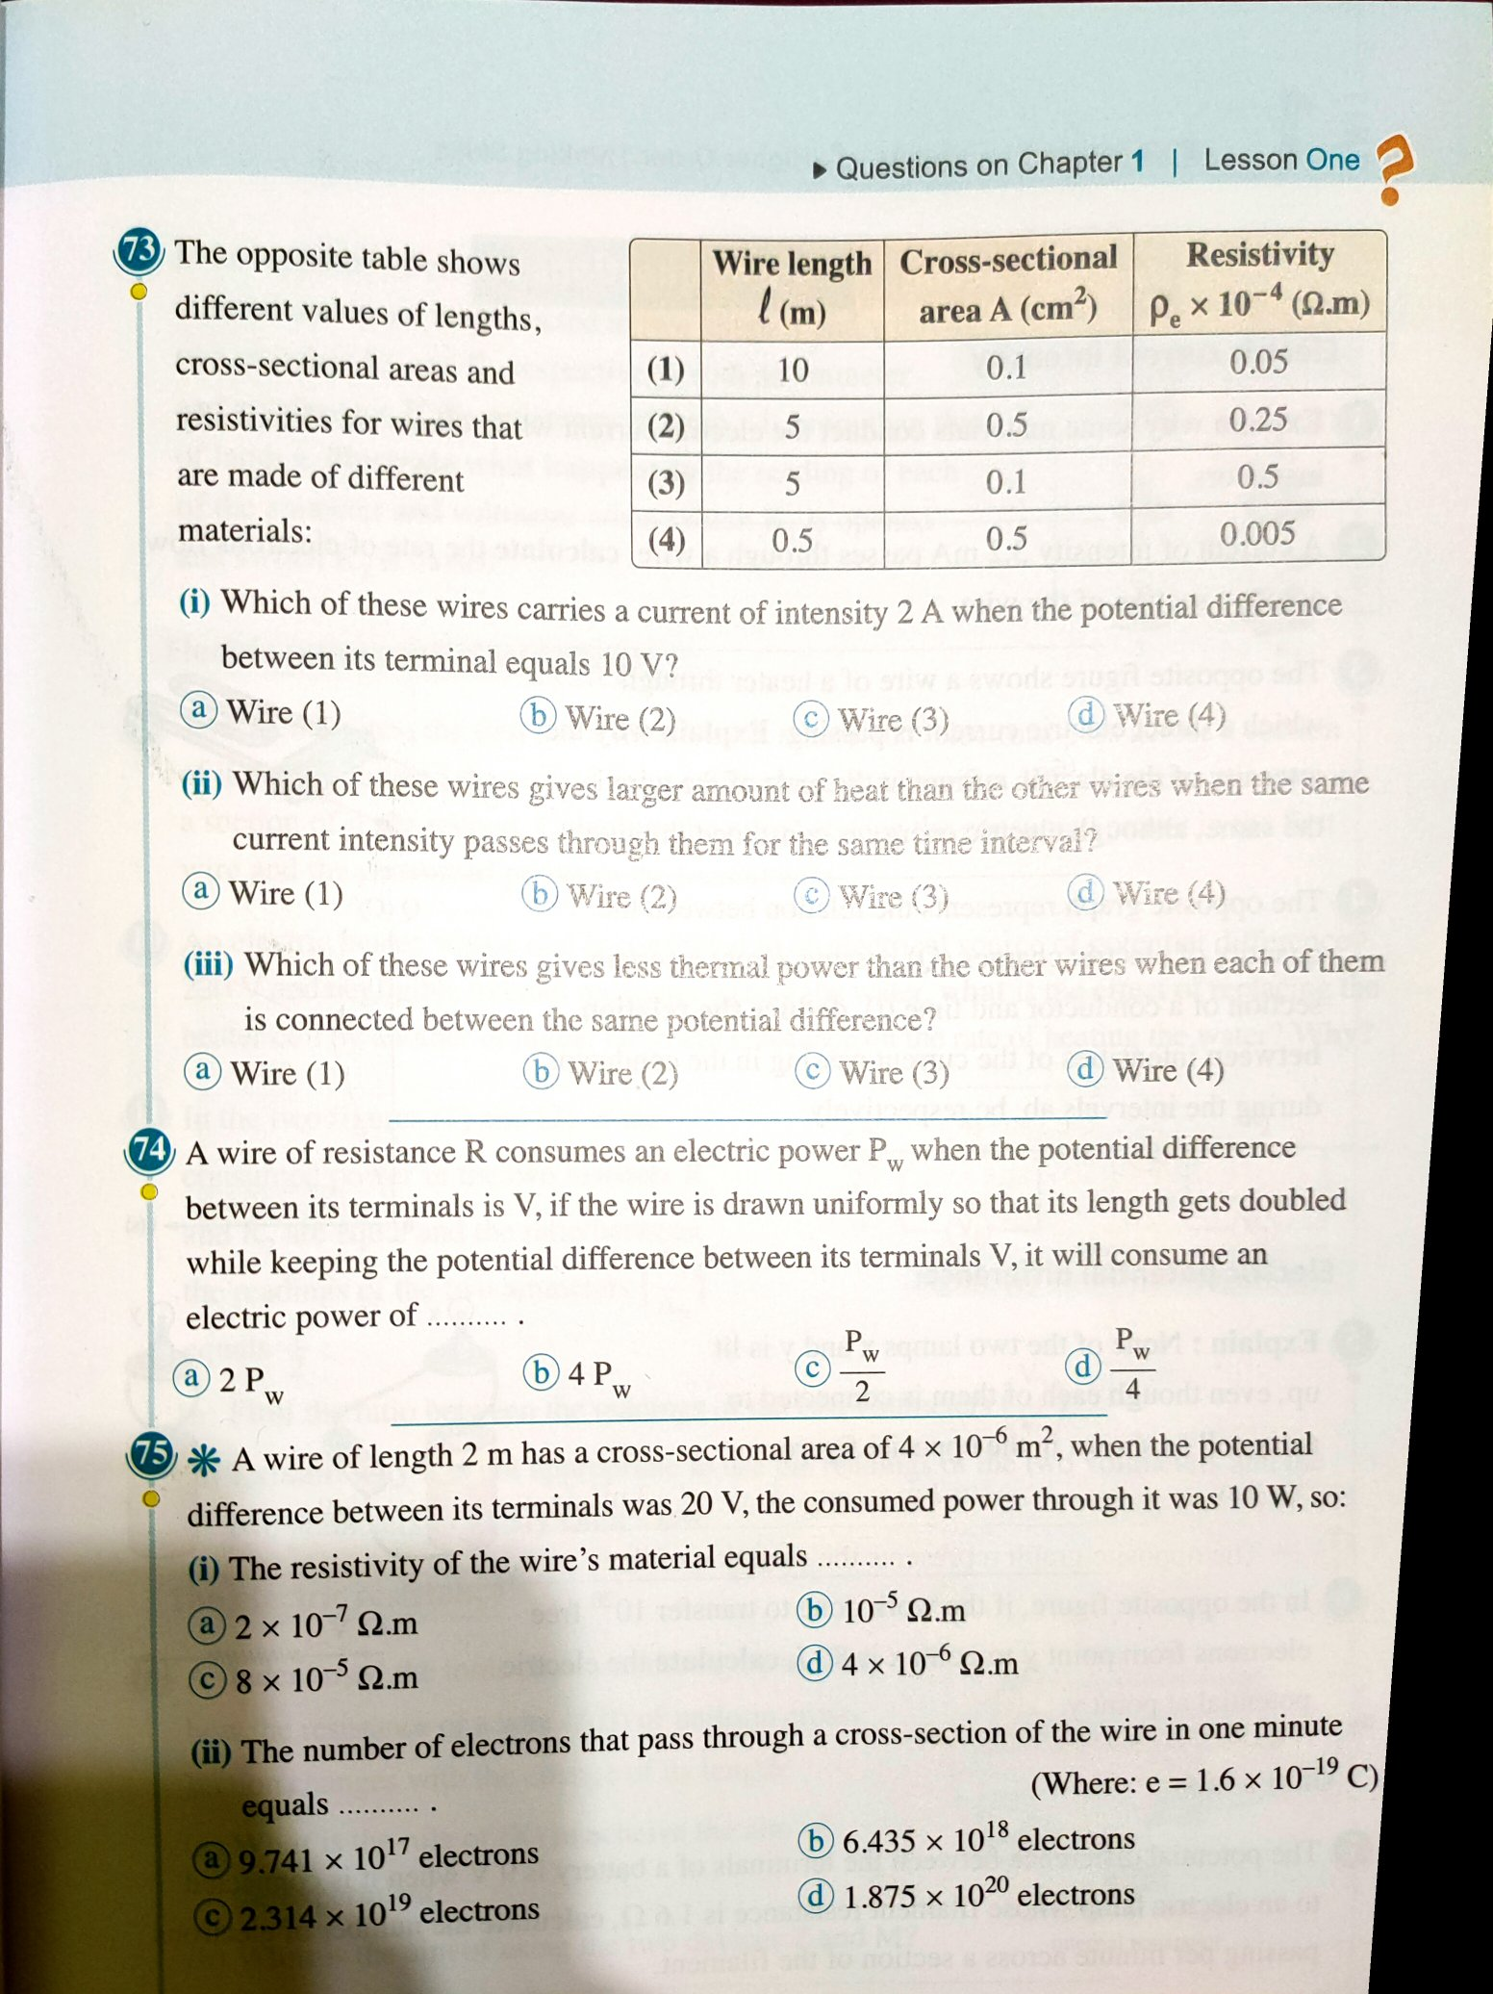
Homework
Notes:
What is the answer to question 74?

Slide 10
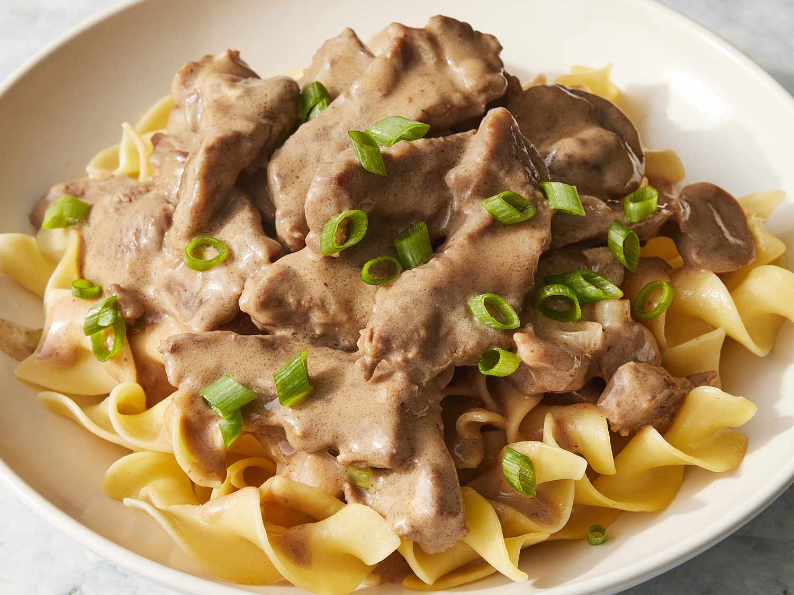
Cooking
Notes:
What dish is this?

Slide 11
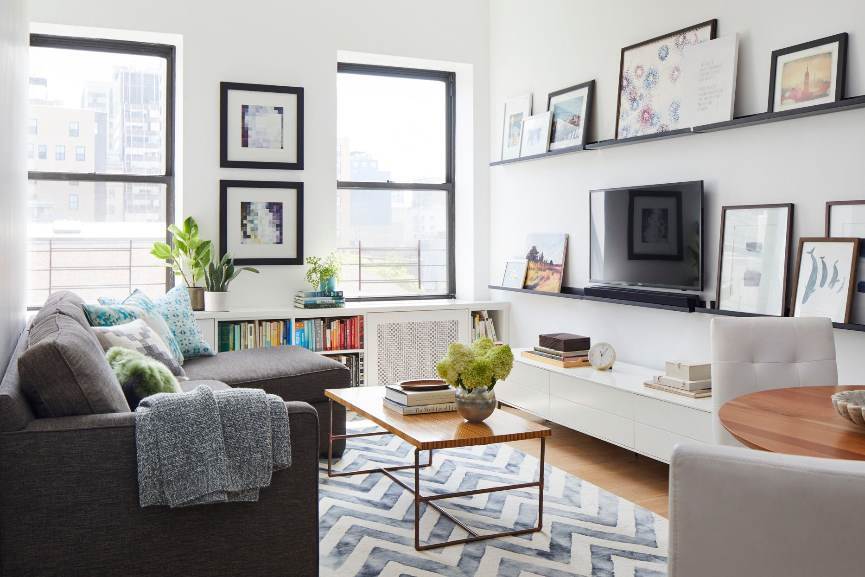
Home Decor
Notes:
Is this setup Feng Shui?

Slide 12
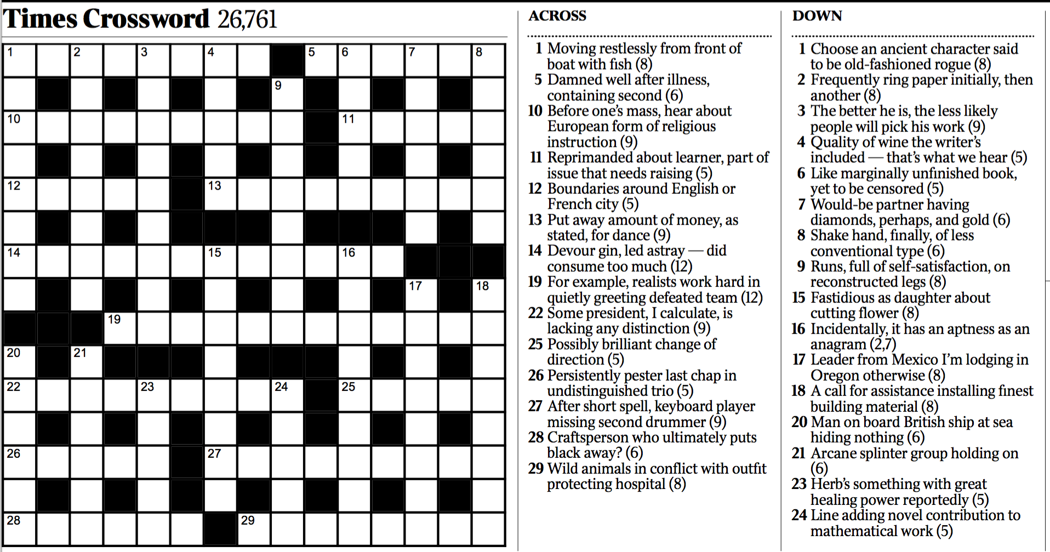
Crossword Puzzle
Notes:
What is the answer to 20 down?

Slide 13
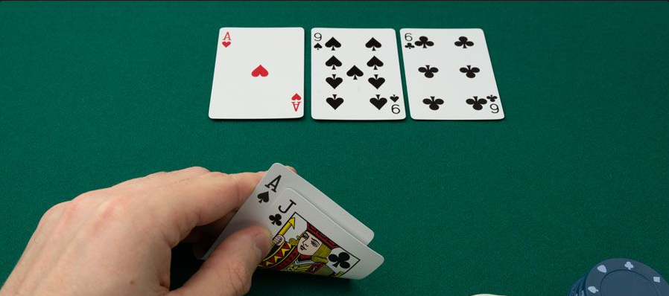
Poker
Notes:
What is the best hand I have here?

Slide 14
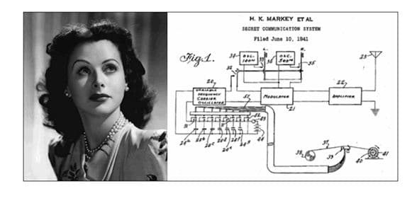
Relationships Between Images
Notes:
How are these two images related?

Slide 15
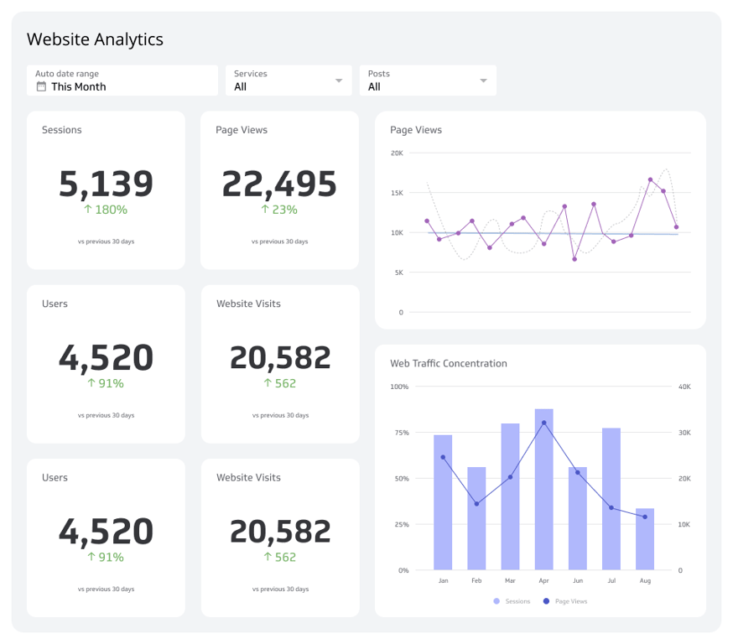
Code
Notes:
Give me css, html, and javascript to create this dashboard.

Slide 16
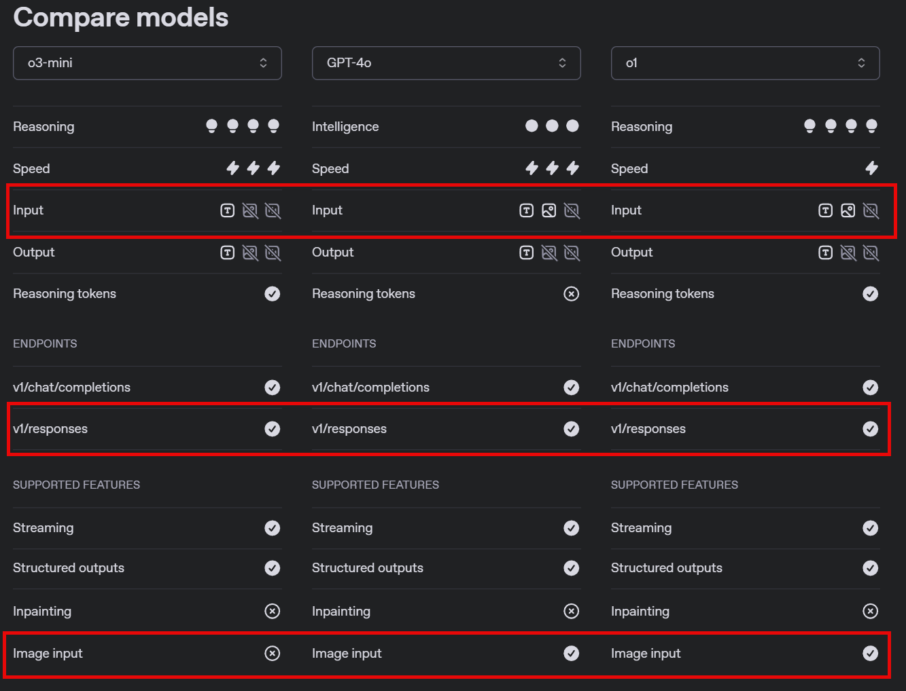
Notes:
https://platform.openai.com/docs/models/compare

Slide 17
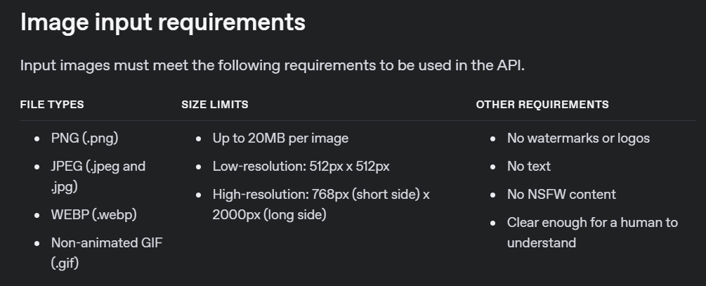
Notes:
https://platform.openai.com/docs/guides/images#image-input-requirements

Slide 18
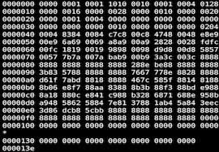


Base64 Image
Image URL
Responses API

Slide 19
DEMO: Using Vision with Image URLs

Slide 20
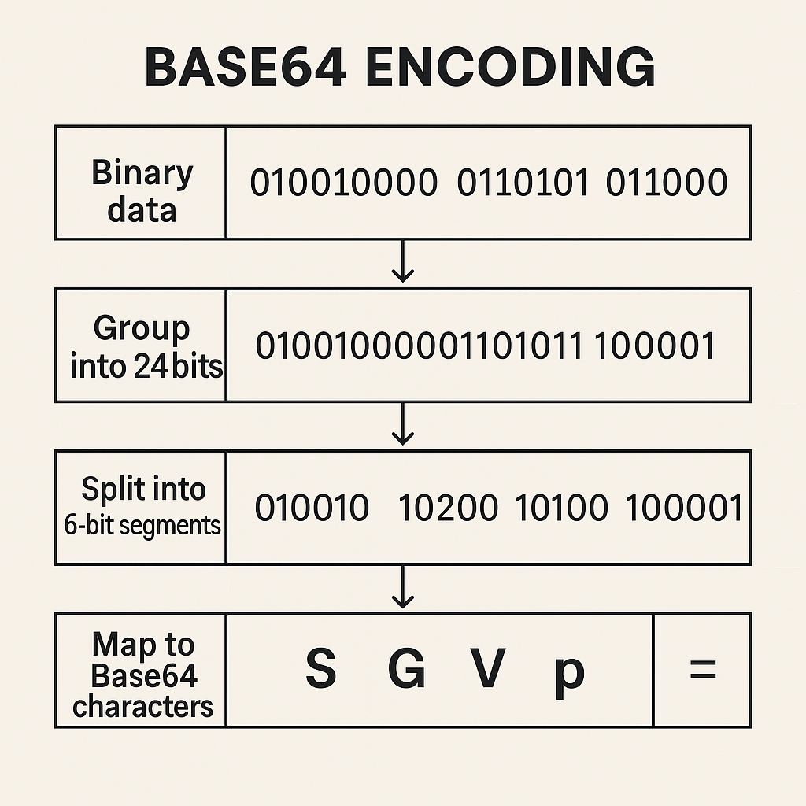
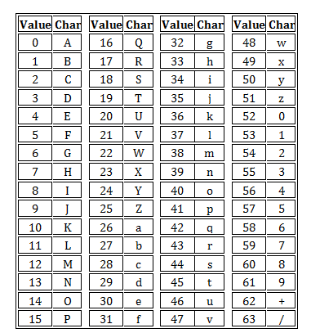

Slide 21
DEMO: Using Vision with Base64 Encoded Images
Notes:
https://www.pixelstech.net/article/1457585550-how-does-base64-work

Slide 22




Notes:
https://www.youtube.com/channel/UC35ZpwldGw7ZJ5R-2sLijzw

Slide 23
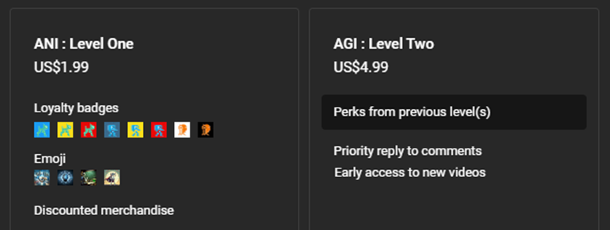

Notes:
https://www.youtube.com/@reallyeasyai/join

Slide 24
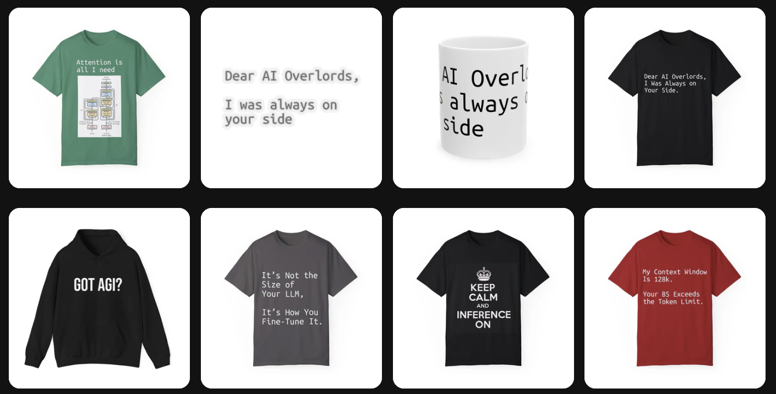
https://shop.reallyeasy.ai
Notes:
https://shop.reallyeasy.ai

Slide 25

https://www.youtube.com/@ainewsfresh
Notes:
https://www.youtube.com/@ainewsfresh

Slide 26

https://www.youtube.com/@aipaperspodcastdaily
Notes:
https://www.youtube.com/@aipaperspodcastdaily

Slide 27
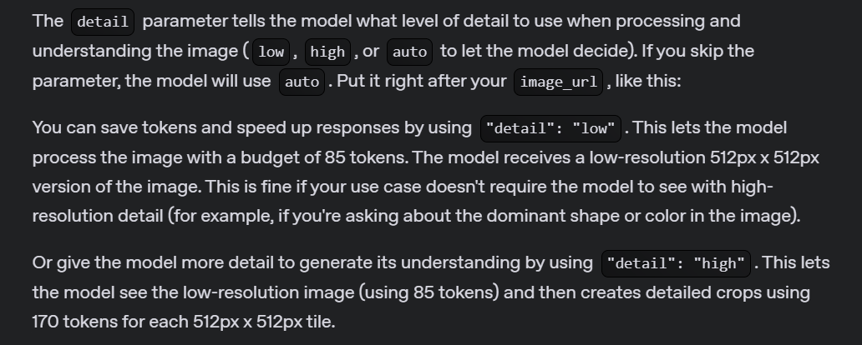
Detail Parameter
Notes:
https://platform.openai.com/docs/guides/images#specify-image-input-detail-level

Slide 28
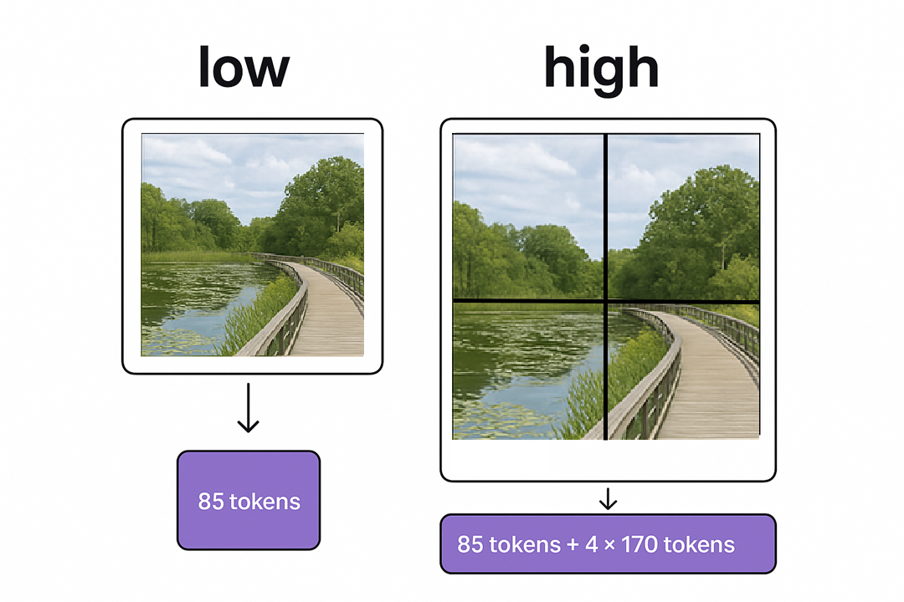

Slide 29
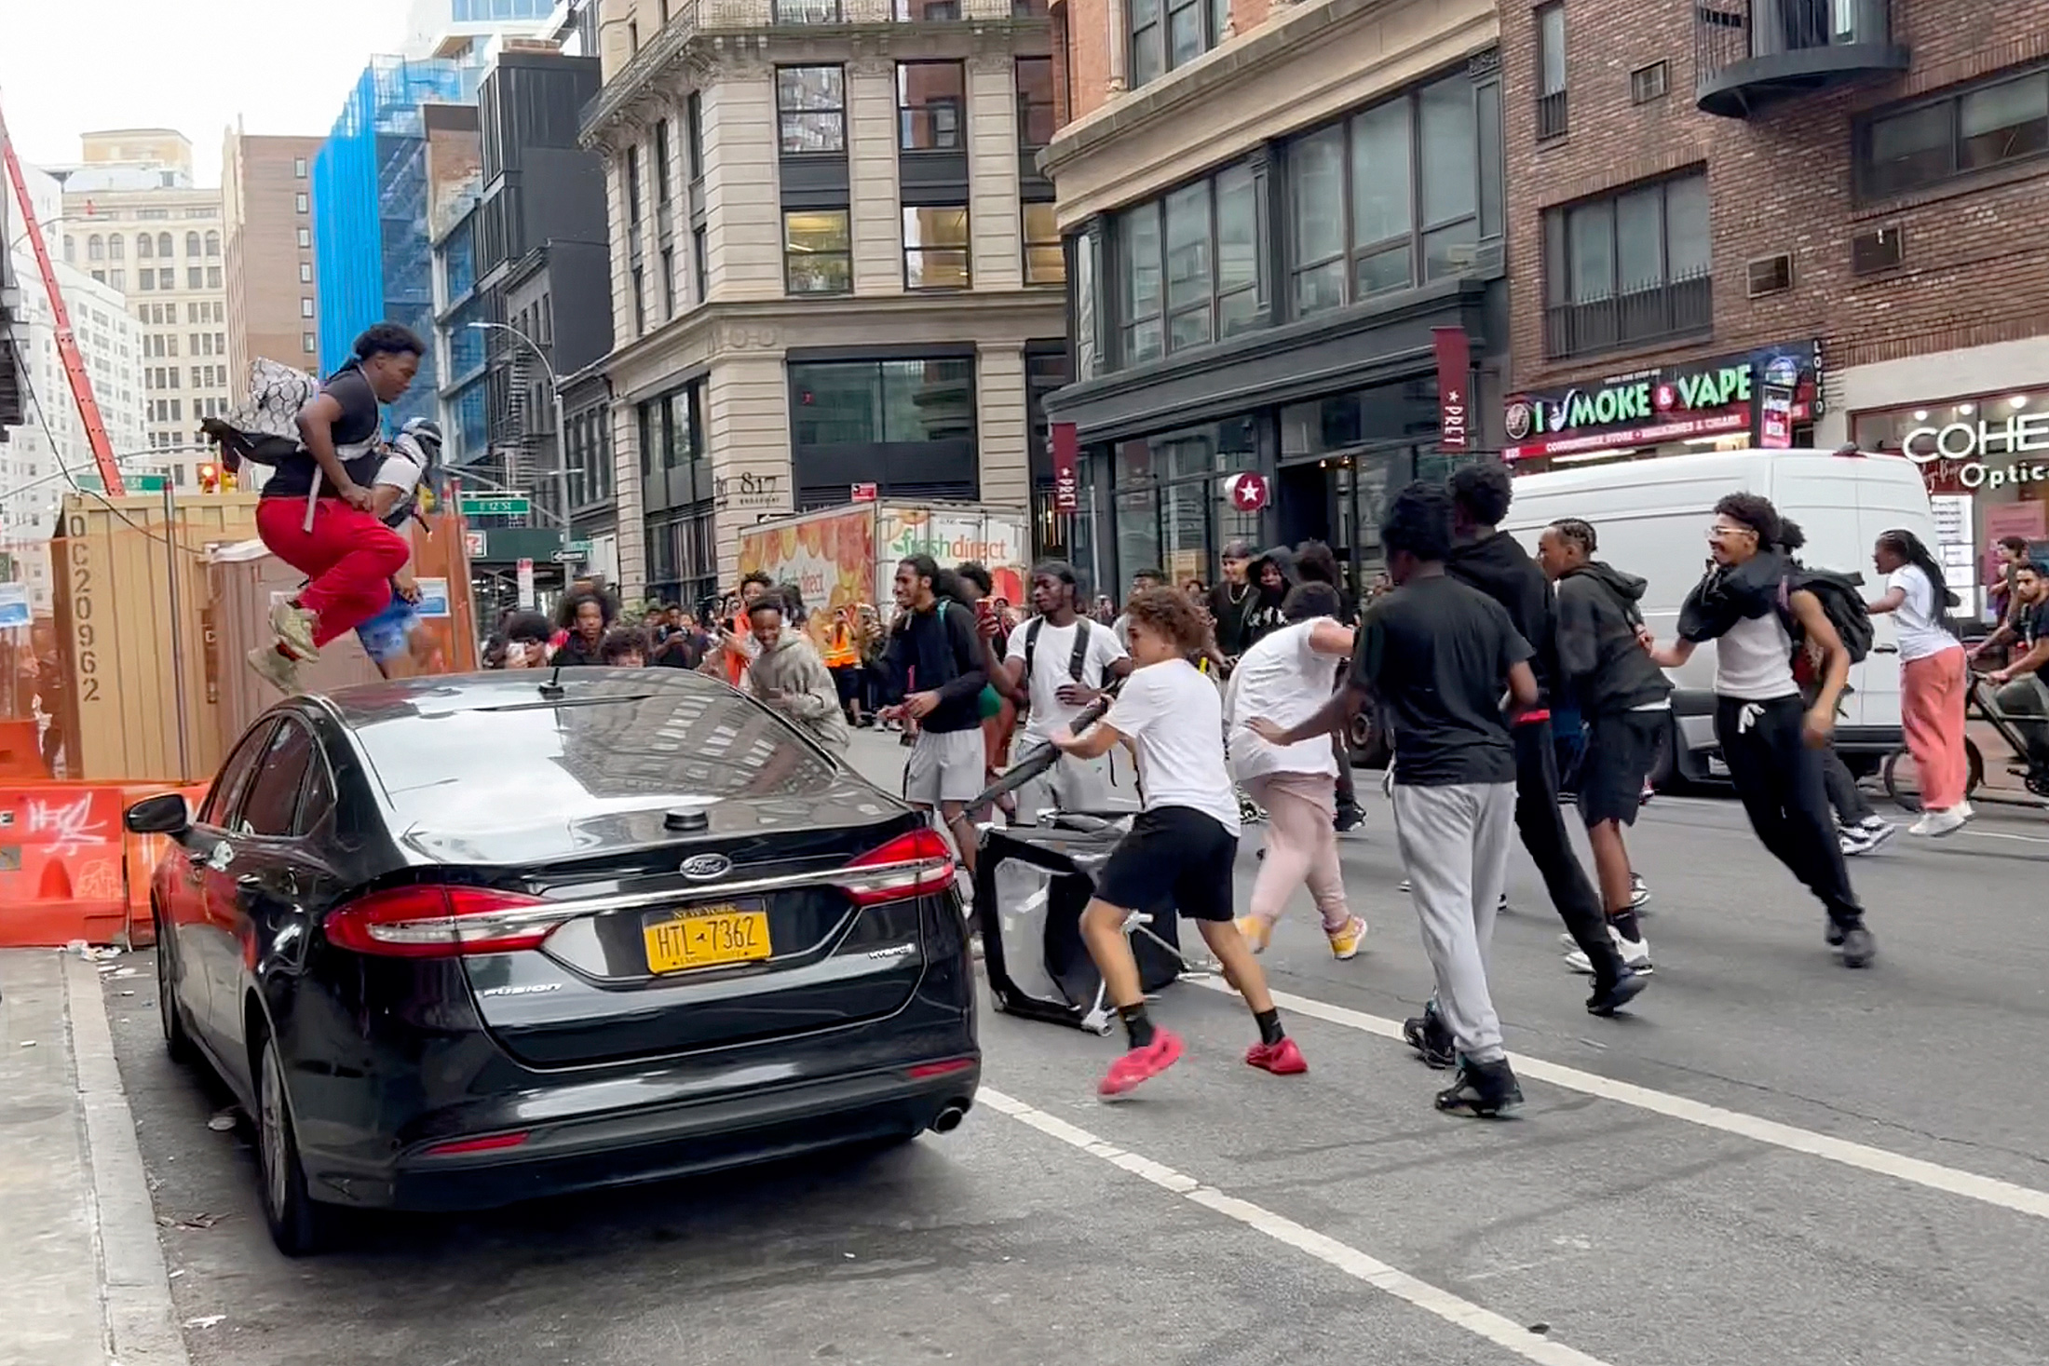
Notes:
https://www.toledoblade.com/news/nation/2023/08/04/Crowd-overwhelms-New-York-City-s-Union-Square-tosses-chairs-climbs-on-vehicles-1/stories/20230804143

Slide 30
DEMO: Using the Detail Parameter

Slide 31
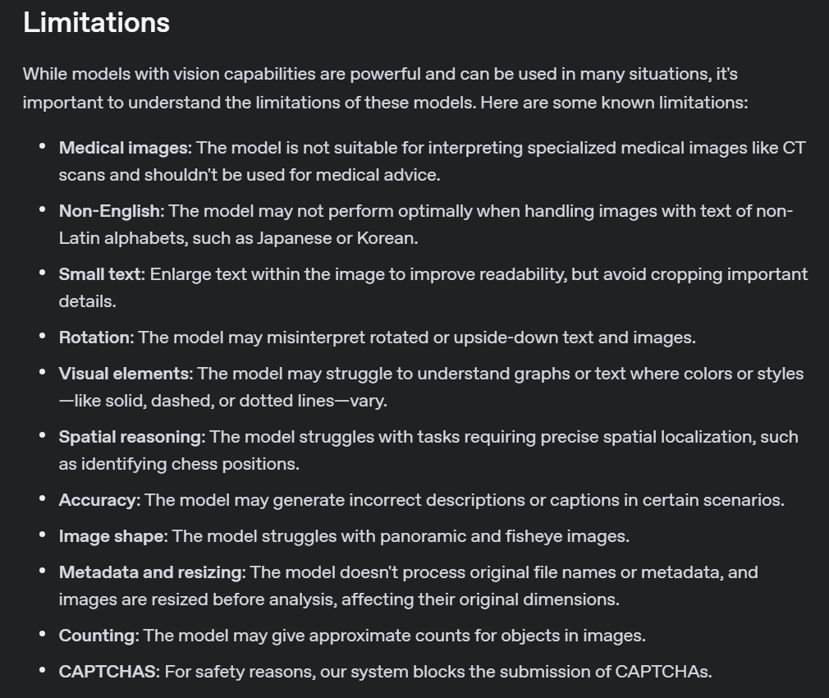
Notes:
https://platform.openai.com/docs/guides/images#limitations

Slide 32
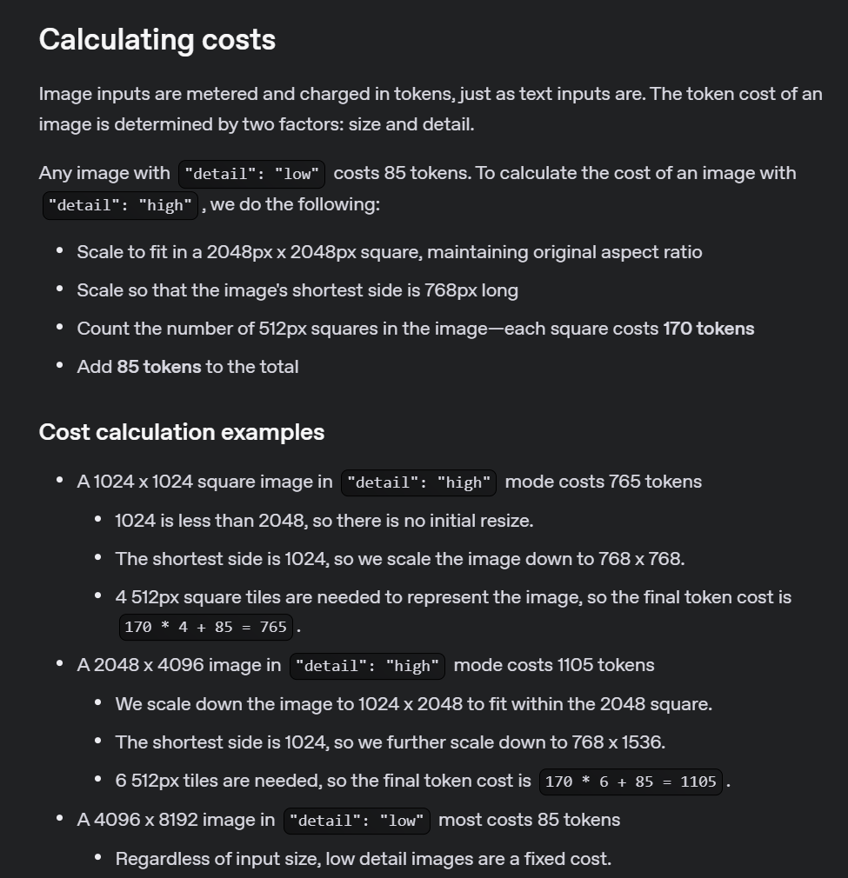
Notes:
https://platform.openai.com/docs/guides/images#calculating-costs

Slide 33
OpenAI API
responses
vision

